Slide 1
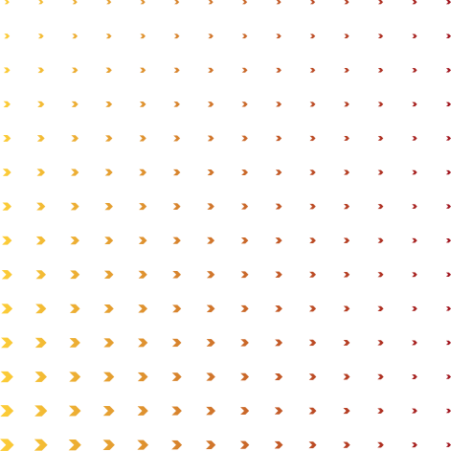



MSDS 6306: Doing Data Science
Case Study 02- Final Project
Presented by: Waleed Amer

Slide 2

Data Set Introduction and Initial Observations
Agenda
Deep Dive into Attrition Analysis
Salary Prediction Through Regression Analysis
Presented by: Waleed Amer
Synthesizing Attrition and Salary Predictions
Job Role-Specific Trends and their Impact
Actionable Business Recommendations

Slide 3
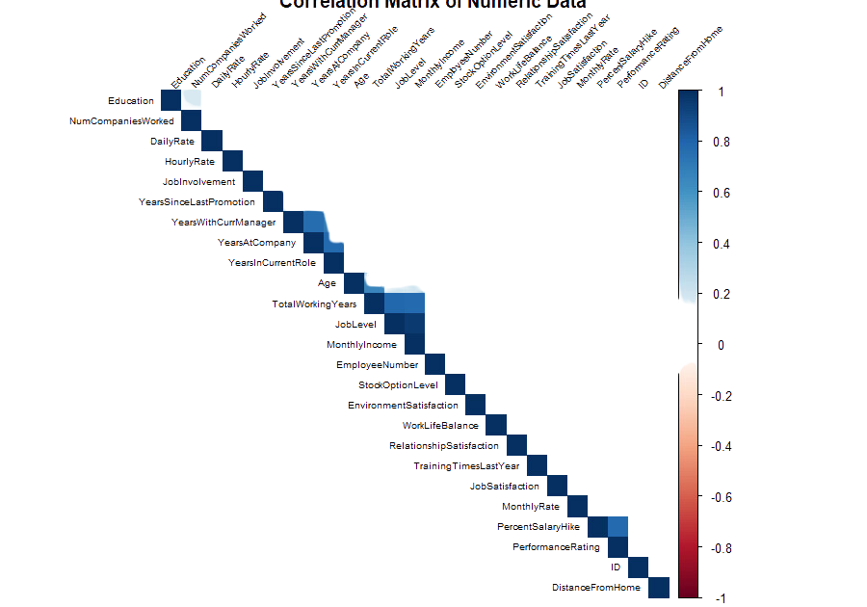
DATA SET INTRODUCTION AND INITIAL OBSERVATIONS
Case Study 2 Data
The dataset contains records for 870 employees
In total, there are 9 categorical variables and 19 numerical variables
Variety of information on Employees

Slide 4
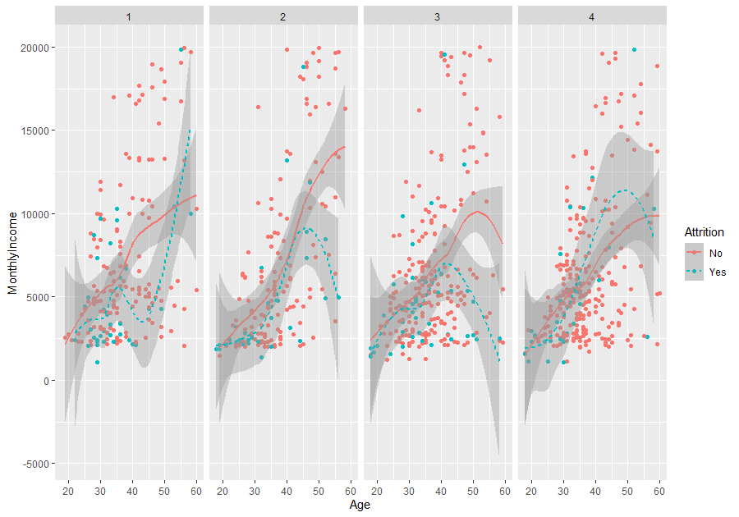
DEEP DIVE INTO ATTRITION ANALYSIS
EDA
Job Level has a higher coefficient than 'Department' in predicting 'Monthly Income'
Job satisfaction and monthly income have a correlation coefficient of 0.6.
Add even more
sub-ideas
Higher attrition among younger employees, especially those earning below $5,000.
Factors: Job Satisfaction, Age and Monthly Income

Slide 5
DEEP DIVE INTO ATTRITION ANALYSIS
KNN MODEL PERFORMANCE
Imbalanced Classes more non-attrition (730) than attrition cases (140)
Model Bias Toward Majority Class
LINEAR REGRESSION MODELS
Simple Model (Monthly Income ~ Job Satisfaction): Very low R-squared value (0.003)- explains very little of the variance.
Multiple Model (Monthly Income ~ Job Satisfaction + Attrition): inclusion of Attrition (R-squared: 0.029)
Roadmap
INTERACTION MODEL (MONTHLY INCOME ~ JOB SATISFACTION * ATTRITION):
Some significant interactions indicate varying effects based on Attrition status, but overall model fit remains low (R-squared: 0.031).
NAÏVE BAYES WITH FEATURE ENGINEERING
Sensitivity: 78.49% (True Positive Rate; the model's ability to correctly predict actual attrition).
Specificity: 71.43% (True Negative Rate; the model's ability to correctly predict actual non-attrition).
Threshold adjustment, 0.6 was found as the optimal cut-off.

Slide 6
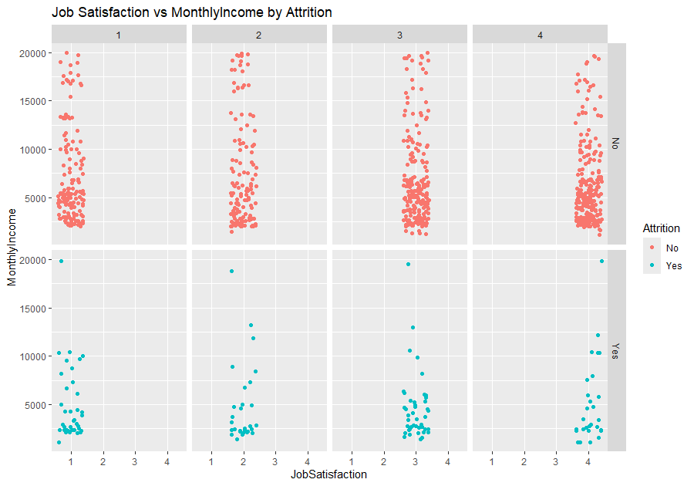

Naïve Bayes with Feature Engineering
Accuracy: Approximately 77.36%.
Sensitivity: 78.49% (True Positive Rate; the model's ability to correctly predict actual attrition).
Specificity: 71.43% (True Negative Rate; the model's ability to correctly predict actual non-attrition).
P-Value : <2e-16
Engineered Features: Income bands, interaction term between job satisfaction and income, high-income flag, and satisfaction-adjusted income.

Slide 7
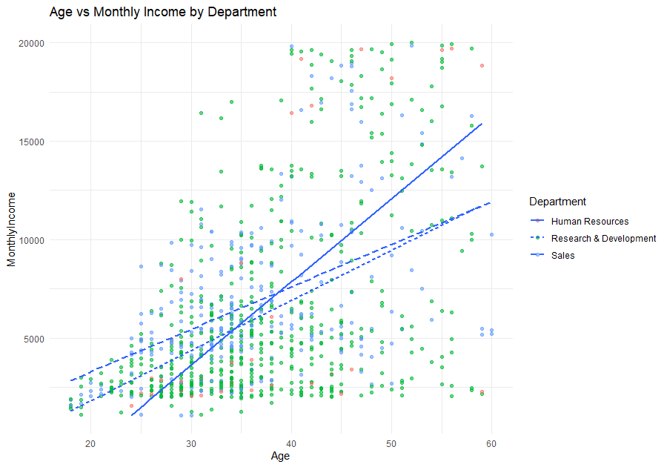
Salary Prediction Through Regression Analysis
Linear Regression with Selected Features
Selected Features: Age, Department, YearsAtCompany, JobLevel, TotalWorkingYears
The model achieved an RMSE of approximately 1367.12
R-squared: Approximately 91.12%,
p-value: < 2.2e-16

Slide 8
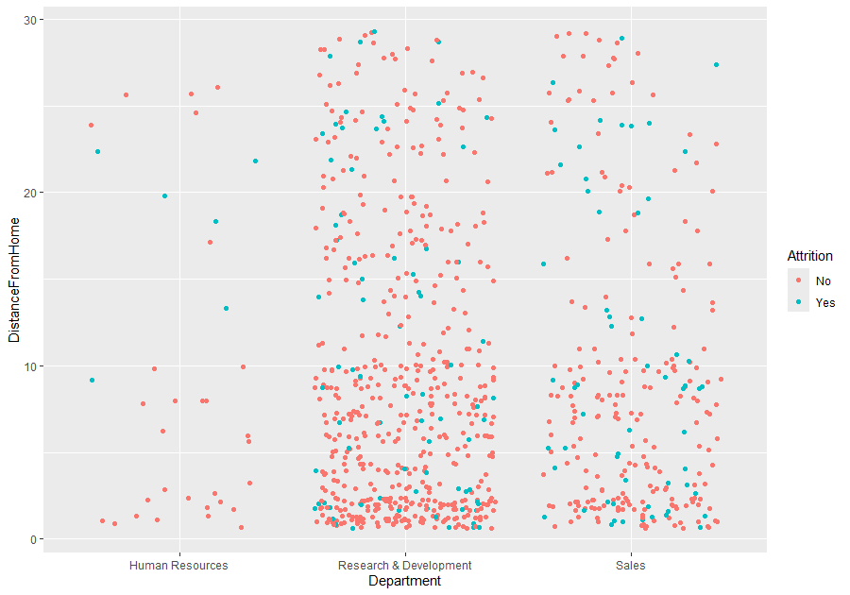
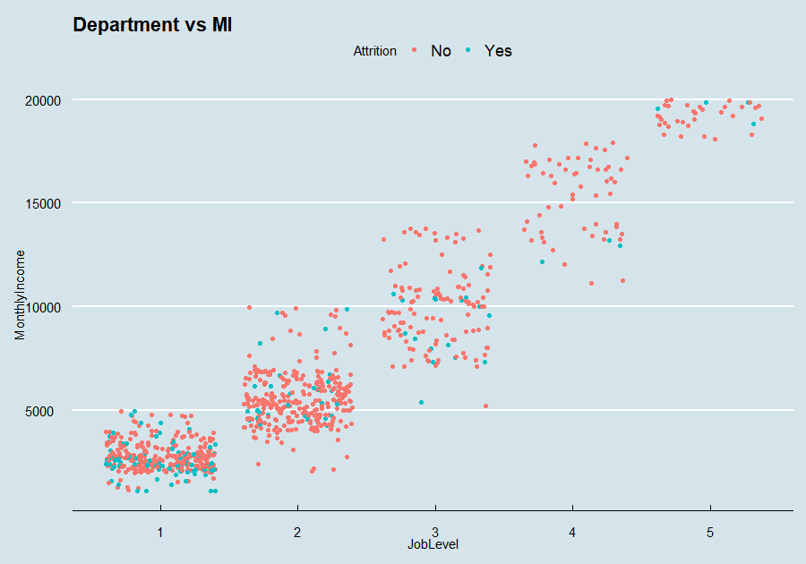
Synthesizing Attrition and Salary Predictions
Salary
Departmental Differences
Statistical Confidence in Predictive Models
Interplay of Age and Income on Attrition
Salary as a Determinant of Attrition
Pivotal factor in both salary levels and attrition rates.
High R-squared values
low RMSE

Slide 9
Job Role-Specific Trends and their Impact
Job Satisfaction Influence on Salary and Attrition | Salary Discrepancies Across Departments | Turnover Rates Despite High Satisfaction
Roles with higher job satisfaction (scores above 3.5 on average) did not show a proportional decrease in attrition | Sales reported a higher average monthly income of $6,500, yet exhibited a 20% attrition rate R&D, with a lower average monthly income of $5,800, showed a reduced attrition rate of 12%. | Satisfaction alone is not a decisive factor in retention
Job Level Impact on Income and Attrition | Departmental Attrition Patterns | Years at Company vs. Attrition
Advanced job levels (levels 4 and 5) attrition rate only 2% lower than at entry job levels. | The Sales department showed a stark contrast with a 20% attrition rate. | Employees with 1-5 years at the company exhibited a 10% higher attrition rate compared to those with 6-10 years, who averaged a 7% attrition rate.

Slide 10


Actionable Business Recommendations
Competitive Salary Review
Targeted Retention Programs
Enhanced Job Satisfaction Measures
Flexible Work Arrangements
Revise Salary Structure
Policy Changes for High-risk Groups
Foster Internal Mobility
Implement Predictive Analytics

Slide 11
HTTPS://GITHUB.COM/WAMERSMU/CASESTUDY2DDS
Resource Page
WAMER@SMU.EDU
Thank You!

